Slide 1


THE AMBASSADORS ALUMNI ASSOCIATION
Reg. No. 4537
POST GRADUATE GOVERNMENT COLLEGE FOR GIRLS SECTOR 42 CHANDIGARH

Slide 2
The College Alumni Association is registered as “The Ambassadors Alumni Association” under the Registration of Societies Act 1957. (registered on 20th October, 2015 with Reg. No. 4537).
An Annual Registration Drive is organized every year on Convocation. During the event, the students are apprised about the objectives and the functioning of the Association and are encouraged to become members of the Association.
The membership is awarded at a minimal fee, which adds into the existing Alumni fund which is deposited in a Current Bank Account in Punjab and Sind Bank, Sector 42, Chandigarh.
Facebook Page: The Association also maintains a Facebook page by the name of “The Ambassadors Alumni Association” which is an open group for all the alumni. (https://www.facebook.com/groups/204400062913636/?ref=share)
A “Canada Chapter” has been initiated by the endeavours of our Alumna Ms. Sanya Kalia and our former faculty member, Dr. Veerpal Kaur, both settled in Canada.

Slide 3
The following events took place during the sessions 2021-22 and 2022-23:
Alumni meet was held on 30.11.2021.
Talk by our illustrious alumni Ms. Shilpa Singhal (C.A) on 24.05.2022.
Annual registration drive was conducted on Convocation Day i.e. on 28.05.2022.
New Office bearers were appointed on 02.07.2022.
40th Founder’s day of the College was celebrated on 16.07.2022.
A seminar on “Careers in the Army: Interaction with Major Tanya Anand” conducted on 10.9.2022.
Interaction with alumni achievers (Ms. Gurmeet Kaur, Lt. Saloni, Ms. Vyjanti) was organized on 22.10.2022.

Slide 4
OFFICE BEARERS
Principal- Prof. (Dr.) Nisha Aggarwal
Chief Patron
Conener- Ms. Nirupinder Kaur
President- Mrs. Shilpa Singhal
Vice President- Dr. Divya Sharma
Treasurer- Dr. Radha Chauhan
Secretary- Dr. Sunaina Jaswal
General Secretary- Dr. Nidhi Rana
Organizing Secretary- Ms. Perismile Kaur
New Office bearers were appointed on 02.07.2022

Slide 5
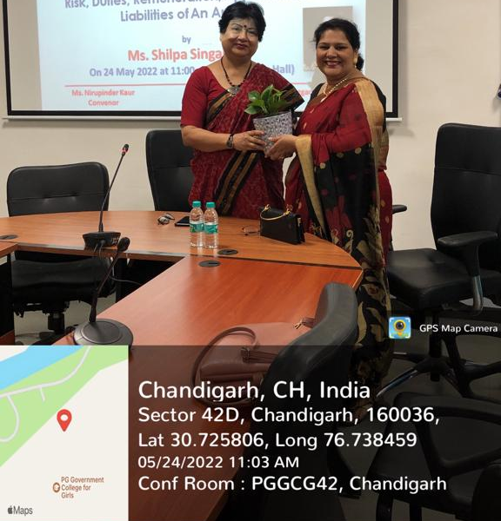
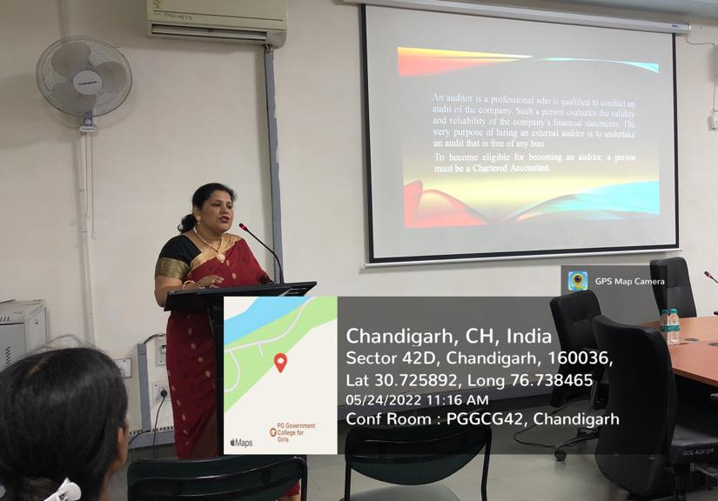
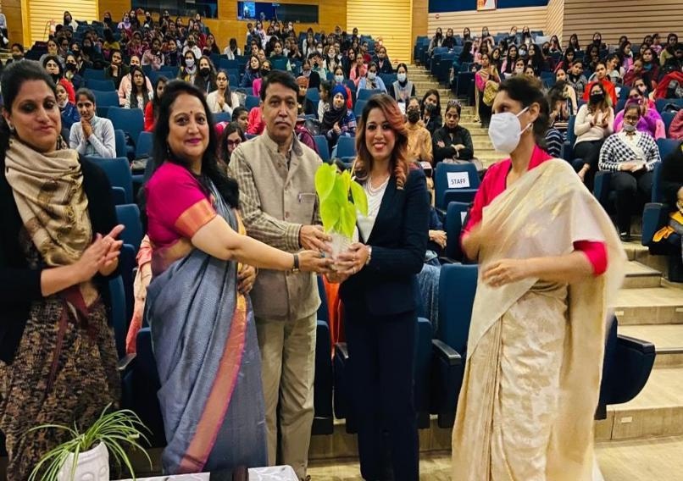
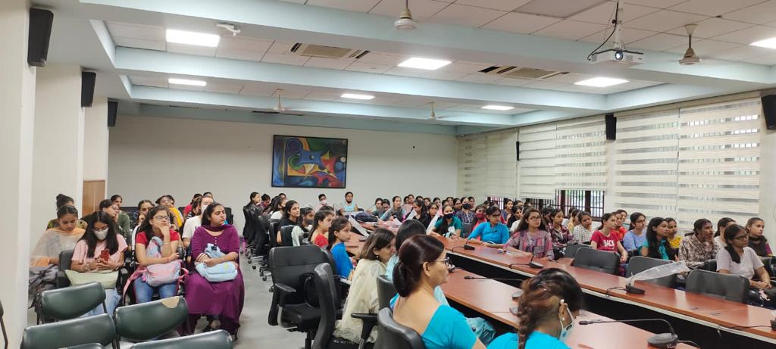
Alumni meet was held on 30.11.2021
Talk by our illustrious alumni Ms. Shilpa Singhal (C.A) on 24.05.2022

Slide 6
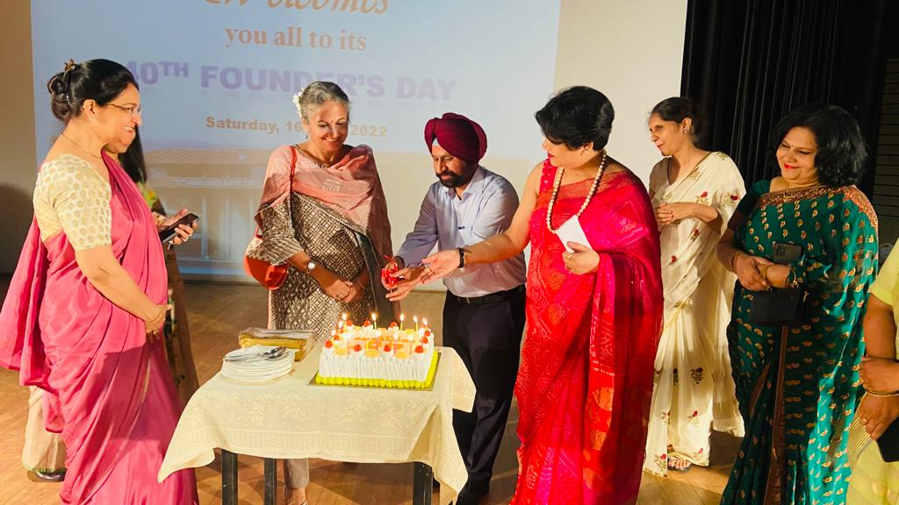
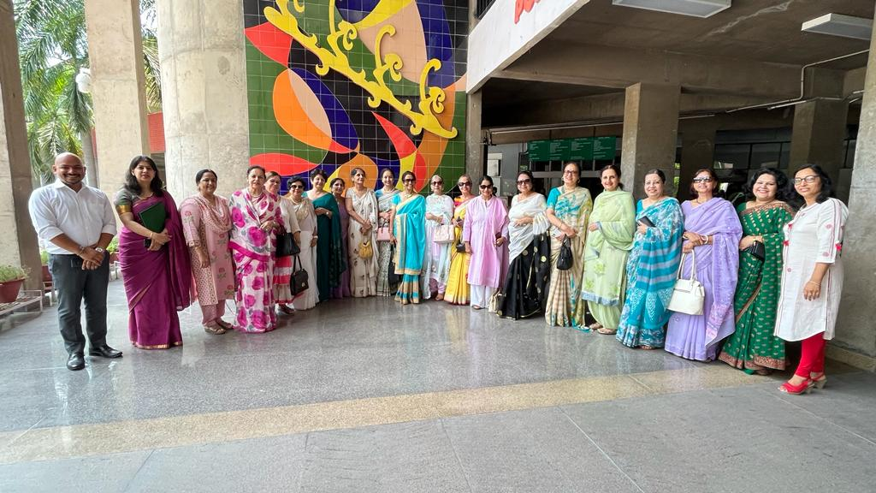
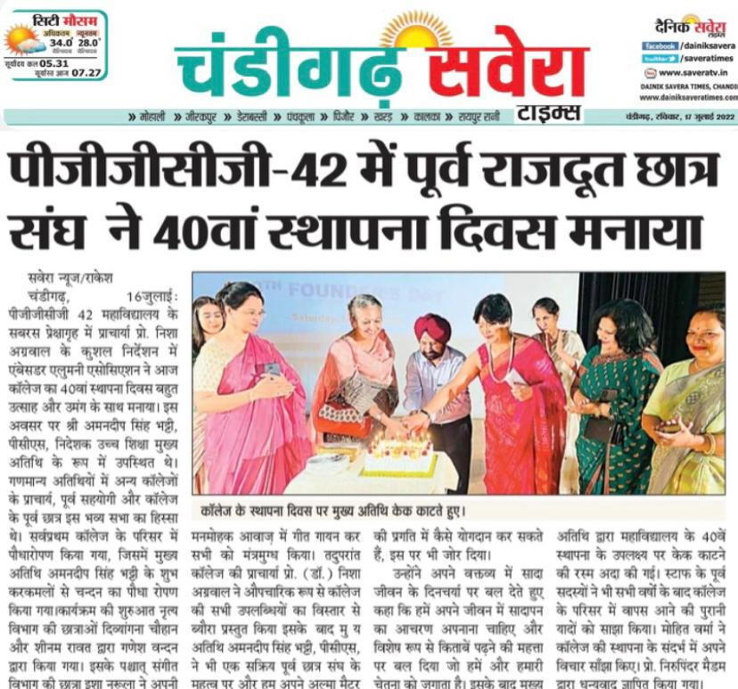
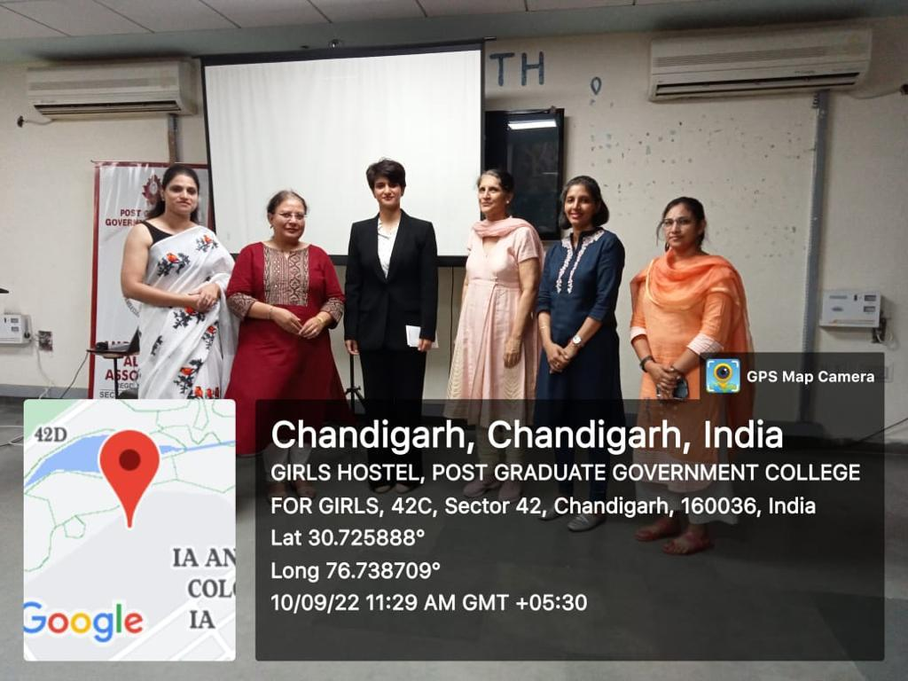
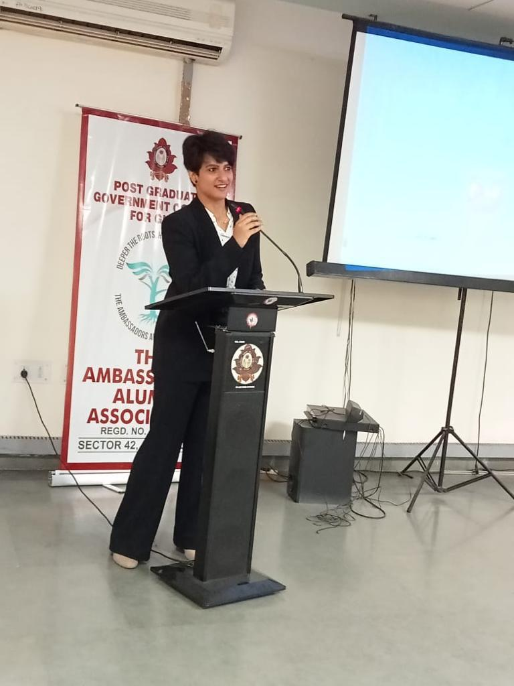
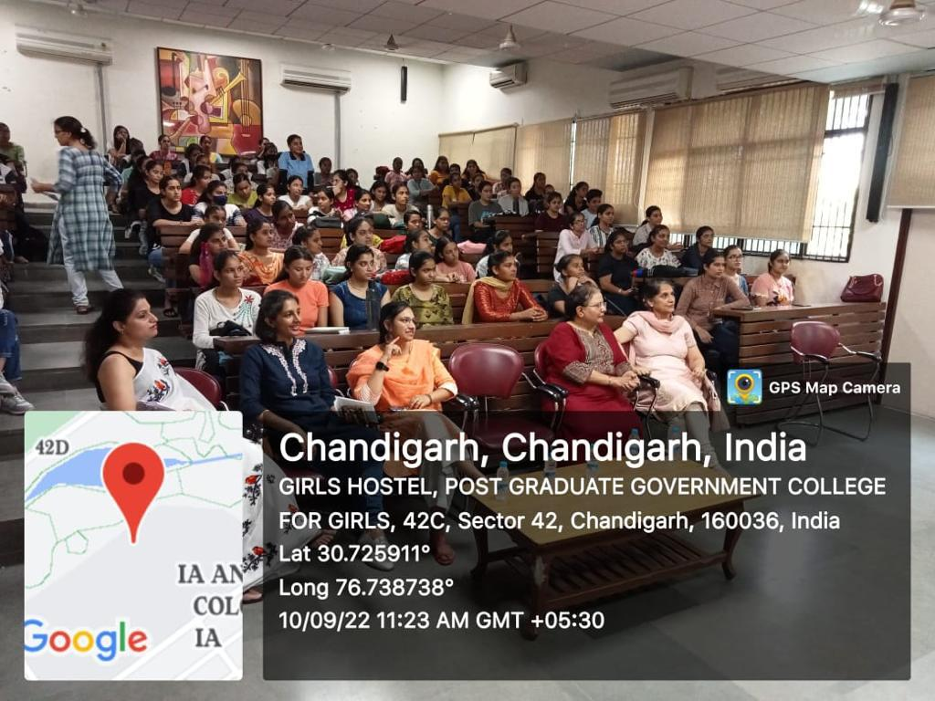
40th Founder’s day of the College was celebrated on 16.07.2022
A seminar on “Careers in the Army: Interaction with Major Tanya Anand” conducted on 10.9.2022

Slide 7
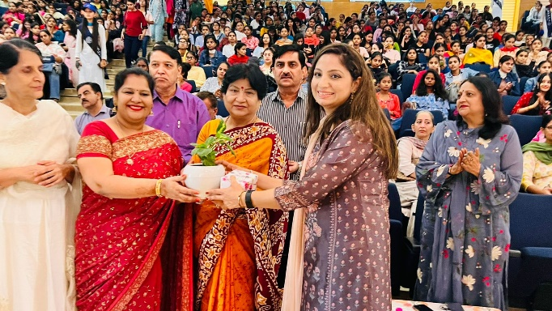
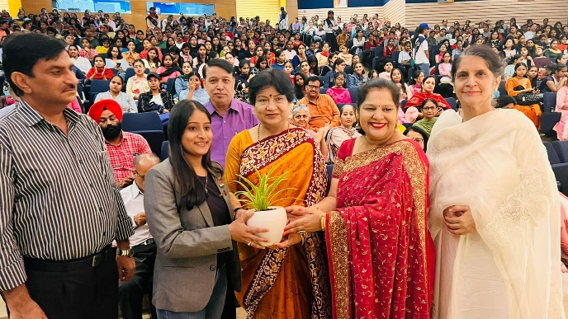
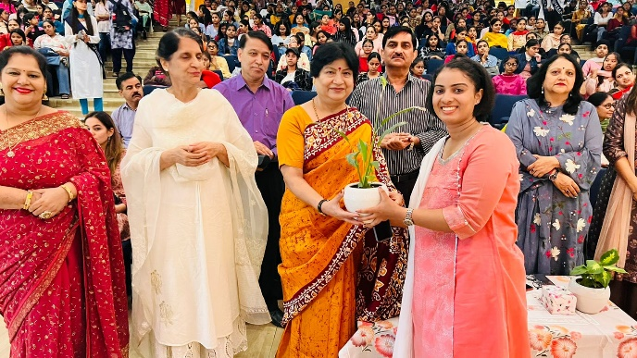
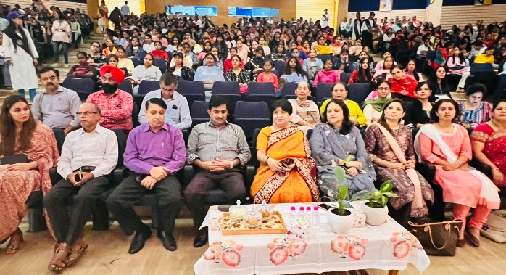
Interaction with alumni achievers (Ms. Gurmeet Kaur, Lt. Saloni, Ms. Vyjanti) was organized on 22.10.2022

