Slide 1
B A III FUNCTIONAL ENGLISH PAPER- B
WEEK 1&2
Monica Singh
Jasreet Kaur
PGGCG-42, Chd.

Slide 2
BUSINESS COMMUNICATION
Writing skills
Personal letters
Business letters

Slide 3
Writing Skills
Writing is an expression
Writing is to communicate ideas, facts, impressions, analysis, synthesis, conclusion and thesis.

Slide 4
Personal letters
Purely personal matters concerning our family relationships, friendships and various social interactions come under such letters.

Slide 5
Elements of a personal letter
The address of the sender
Date
Salutation
Body
The subscription and
signature

Slide 6
Business letter
A form of communication between two or more authorized persons of an organization or two different organizations or even between an individual and an organization

Slide 7
Elements of a business letter
Heading
Reference number
Date
Salutation
Subject
Body
Complimentary close
The signature

Slide 8
Types Of Business Letters
Application for agency
Letter of complaint
Request for quotation
Reply quotation
An order for some commodity
Acknowledgement of order
reports

Slide 9
Contd….
Letter seeking payment of overdue
Sales circulars
Problem letters
Goodwill letters
Resume with a job application
Memorandum

Slide 10
Format style
Fully indented style
Semi- indented style
Fully blocked style
Modified blocked style
The hanging paragraph style
The Noma – Simplified style

Slide 11
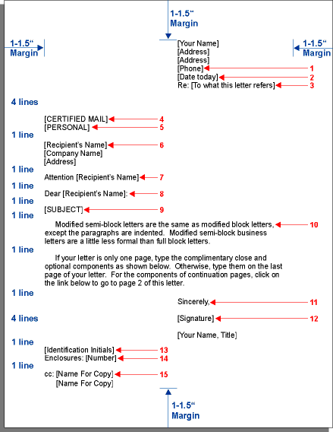
eg. Semi block style

Slide 12
Business letter formats
Block
Unindented paragraphs.
All letter elements are aligned with the left margin.
Modified block
Unindented paragraphs.
The return address, reference line, date, complimentary closing, and signature block are right of centre.
Remaining elements are aligned with the left margin.

Slide 13
Contd.
Semi block
Indented paragraphs (usually an equivalent of five spaces).
The return address, reference line, date, complimentary closing, and signature block are right of centre.
Remaining elements are aligned with the left margin.

Slide 14
Contd….
Simplified
Unindented paragraphs.
The salutation and complimentary closing are omitted.
All elements are aligned with the left margin.
Full Block
All elements of the letter are left aligned

Slide 15
Have A Nice Day

