Slide 1
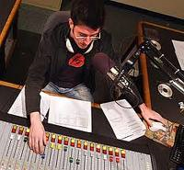
RADIO/T V PERSONNEL
PERSONAL CHARACTERISTICS/QUALITIES

Slide 2
Production personnel
To work in a team production people need to have good communication skills.
The most important quality for production people is to be good organizers with initiative and the ability to work on their own.
They need sensitivity, tact and confidence while dealing with others.
Clarity in speech, normal eye sight and colour vision are necessary for PAs in television and,
clear speech and diction for the radio.
PAs should be able to remain calm when working under pressure and should react quickly in an emergency.
Good concentration is essential. Pleasant temperament is an asset.

Slide 3
Researchers
Researchers need to be innovative and enthusiastic,
inquisitive and resourceful as well as
methodical and painstaking in their work.
They must then be able to organize this material expressing themselves clearly in writing.
Researchers should be able to draw on reference sources and production processes.
Researchers need excellent interpersonal skills.
They should be outgoing, capable of building good rapport with people and should be able to draw information from them.
Researchers are generally warm, receptive and mature.

Slide 4
Floor managers
Floor Managers should have good communication skills and should be friendly and outgoing.
They should be capable of giving precise instructions to other members of the production team, as well as to receive guests.
Floor Managers need an understanding of the technical aspects of production to work with the technical crew.
Leadership qualities, physical stamina are important for this work.

Slide 5
Camera personnel
Technical expertise, artistic ability, an appreciation of colour, shape and composition and an understanding of electronics and optics are the key elements for success with the camera.
Working under pressure, in dangerous areas and filming distressing scenes such as those of fire or famine are very common for the camera person. Hence they should be able to withstand such pressures.

Slide 6
Camera persons have to work in a team. Hence good communication skills are required.
They may also need considerable initiative to be able to work on their own ; for instance when recording news items.
News cameramen/women need to be adaptable and should be able to carry out many functions.

Slide 7
Sound technicians/engineers
Sound technicians need an appreciation of music and creativity, knowledge, technical ability and an understanding of electronics.
Knowledge of music and the art of maintaining rhythm are required.
Working in difficult distressing situations is a common element of this work.
They should be able to concentrate, work with a variety of people, have the necessary communication skills that are essential for being efficient.

Slide 8
Transmission executives
A person who can get along with others and who is happy to be of service to people, is the one who will be successful in this profession.
Knowledge of the major events around the country and world and the habit of updating is expected.
Since the work requires keeping in close touch with members of the public who come to the station in their capacity as speakers or programme makers, the transmission executive is expected to be good in public relations.

Slide 9
The hours of duty being flexible, a constitutionally robust person is needed to overcome the initial hurdle of an upset sleep cycle.
Hours of duty vary and transmission executive on duty cannot leave the premises till such time as his reliever takes over charge from him, hence, dedication and devotion to duty is paramount.

Slide 10
Reporters
Reporters must possess a good command over the language of use.
The ability to write concisely, the art of conveying the maximum information in the minimum time is the key to success in television/radio. Verbosity is not needed for entry into the medium.
A television/radio reporter's ability to see and think beyond the obvious and approach an issue from a different angle is what separates an outstanding journalist from the average.

Slide 11
They are forever keen to catch news, have keen visual/audio sense with a precise language.
Ability to communicate clearly to the editor for the sequencing of the story is required.
It is imperative for a reporter to stick to a deadline and assigned time.

Slide 12
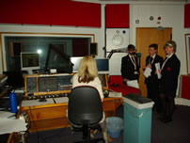

Slide 13
Newscasters
Newscasters need excellent speech,
verbal ability,
diction,
pronunciation and a
good background in journalism.
Ability to work under strict time bound programme,
ability to be composed under stress,
adaptability,
intelligence and
quick response will be required.

Slide 14
Presenters/Anchors
Anchoring is the art of presenting or delivering a programme. It is, in other words introducing the audience to the programme.
An anchor can make or mar a programme.
Presenters need a well-modulated voice,
good timing,
excellent pronunciation,
correct language usage,
a warm, pleasant personality and
a neat and precise appearance (for television).
A good blend of a pleasant appearance and voice with an appealing style usually determines success.

Slide 15
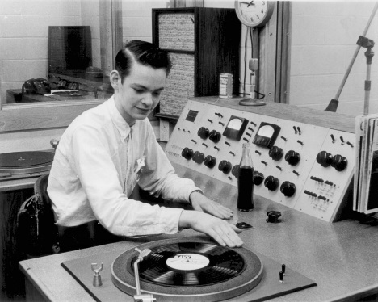

Slide 16
Contd…
The anchor should be telegenic, articulate and should have control over delivery of words.
Besides diction and a quality of expression suitability to the programme is important.
Comperes have to be versatile.
With an outgoing temperament, excellent communication skills and a smart disposition they can do well.
Reaction time should be rapid and general mental ability good.
Good perception, leadership qualities are an asset as is a good appearance.

Slide 17
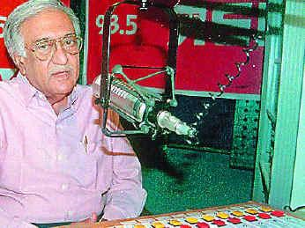
RADIO PERSONALITY—AMIN SAYANI

Slide 18
Contd….
DJs And VJs must have strong interest in music ,
lively inquiring minds,
good communication skills,
pleasant, well-controlled voice,
good timing,
excellent pronunciation, and
correct English usage (Hindi/other regional languages for regional audiences),
total lack of self-consciousness,
plenty of verve and vivaciousness are other attributes which are essential.
Patience,
faith,
a positive attitude,
knowledge about voice modulation are extremely necessary.

Slide 19
