Slide 1
Evolution of internet

Slide 2
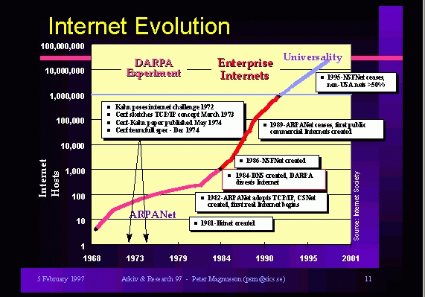

Slide 3
The first step towards the construction of internet taken in 1966.
ARPA requested quotations in 1968
One objective was to build a system that could withstand any systematic attack on central nodes, such as from a nuclear strike.
4 computers on ARPANET in 1969.
In 1973 an effort began to connect ARPANET with mobile networks using synchronous satellites (SATNET) and mobile packet radio (PRNET), this effort became known as “internetting” part of this research effort resulted in Ethernet (in Hawaii)
July 1977 a four-network demonstration linked ARPANET, SATNET, and the PRNET.

Slide 4
TCP/IP version 4 came in 1978.
The new internet protocols, generally called TCP/IP, began to be developed in the early 70s, and ARPANET switched to them in January 1983
Supercomputer centers program in 1986 (Senator Gore’s legislation) led to the NFSNET, which remained the backbone until April 1995
In 1992, The research of NSF leads to the creation of new network called ANSNET(Advanced Network Services).

Slide 5
Network- Atlantic to Europe
The network jumps across the Atlantic to Europe in 1973.
In 1970s the NSF created a common network called CSNET, which allowed dialup connection to ARPANET.
The national science foundation(NSF), join the project and established five “super computing centers” that were available to anyone who wanted to use them for academic research purposes in 1980. ( the agency quickly destroyed that the existing network could not handle the load).
In response NSF created a new, higher capacity network called “NSFnet”.

Slide 6
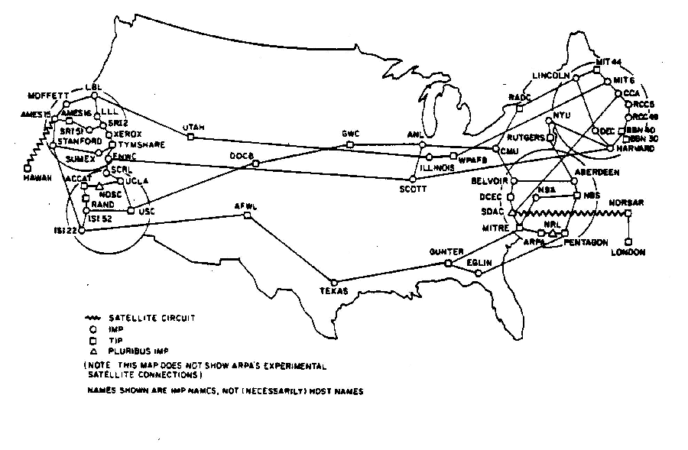
This Shows The Extent Of ARPANET In September 1971

Slide 7
The new internet protocols, generally called TCP/IP, began to be developed in the early 70s, and ARPANET switched to them in January 1983.
In 1990s, interest in the internet begin to expand dramatically.
In 1992, The research of NSF leads to the creation of new network called ANSNET(Advanced Network Services).
In 1995, more advanced version of network called VBNS(Very High Speed Backbone Network System) and replaced ANSNET from the market.
The link between ARPANET, NSFnet, and the other networks was called the internet
“the process of connecting separate networks is called internetworking”.
The original ARPANET was shut down in 1990.

Slide 8

1980s.NSFNET
1969. ARPANET
1990s.INTERNET

Slide 9
internet

Slide 10
Internet
The internet is the network of networks or a global communication system that links together thousands of individuals networks. Virtually any computer on any network can communicate with any other computer on any other network these connections allow users to exchange messages to ,communicate in real time, to share data and programs, and to access limit less stores of information.
Evolution of internet
Services provided on internet
Access methods of internet
www

