Slide 1
Elements of Computer Processing System

Slide 2
What is computer?
Electronic device used to
store,
retrieve, and
manipulate the data

Slide 3
The Basic Components
CPU
ALU
CONTROL
UNIT
INPUT UNIT
OUTPUT UNIT
MEMORY
SYSTEM UNIT

Slide 4
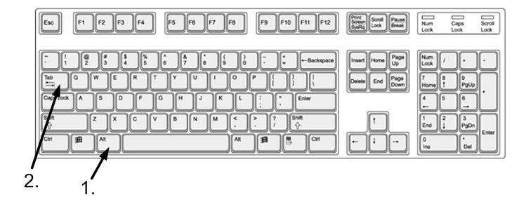
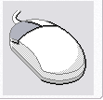
Input devices : feed the computer with raw matter-facts or data.
Keyboard
Mouse
Scanner
Joystick

Slide 5
Output devices: processed data or information is sent to the output device connected to computer.
Monitor
Printer
Plotter

Slide 6
Processing
The storage of data, numerical comparisons, arithmetic operations are performed on data to produce desired results.

Slide 7
Block diagram and Components of Computer
Central Processing Unit
System Bus
Control Unit
Arithmetic and logic Unit
Registers
PC
Main Memory
External Memory
Input Devices
Output Devices
IR

Slide 8
The Block Diagram of Computer includes the general organization and interconnection of different units of computer as shown below:
Central Processing Unit(CPU)
carries out computation and has overall control of the computer.
Main Memory
stores programs and data while computer is running.
External Memory
holds large quantities of information too large for storage in main memory.
Peripheral Devices
I/O devices which allow the computer to communicate with the outside world.

Slide 9
System Bus Allows communication between the component parts of the computer.
Possible transfers of information via system bus are:
Data transmitted from main memory to CPU.
Input data from keyboard travels from the device to main memory.
Information from External Memory is transmitted to main memory.

Slide 10
CPU(Central Processing Unit)
All computations take place in CPU.
Two main tasks of CPU are:
To control the fetching and interpretation of instructions from main memory and the movement of data between memory and the CPU.
To execute instructions.

Slide 11
Main Components of CPU
The Control Unit:
Controls the fetching of instructions from main memory, interpretation and the execution of these instructions and the passing of data to and from the ALU for computation.
ALU:
Carries out arithmetic operations on integers and floating point operands.
Also performs simple logical operations on logical operands(True or False) and can make comparisons between numeric operands.

Slide 12
Registers:
These are small units of memory that the control unit and ALU use for storage of intermediate results and control information.
Special purpose Registers:
PC(Program Counter)
It holds the address of next instruction in memory.
IR(Instruction Register)
It holds instruction currently being executed.

Slide 13
Characteristics of Computer
Speed
Accuracy
Diligence
Versatility
No feeling
Storage

