Slide 1
Electronic Spectra of Transition Metal Complexes
Dr. Gurpreet Kaur
Assistant Professor
PGGCG-42
Chandigarh

Slide 2
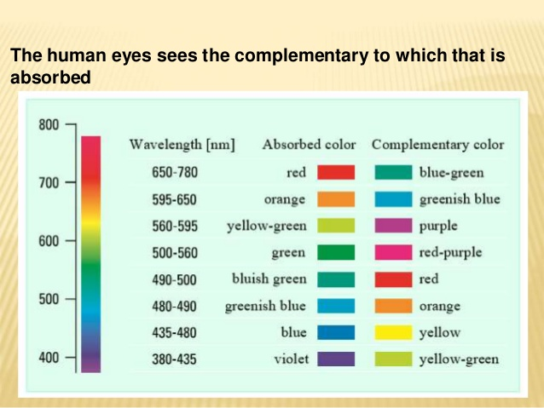
Basis of Electron Absorption Spectroscopy
Transition Metal (TM) compounds appear coloured because they absorb light of particular wavelength of frequency in the visible region. The colour given by the compound is complimentary to the colour of light absorbed.

Slide 3
The extent of intensity of absorption of light of a particular wavelength or a frequency can be obtained by Beer-Lambert Law explained as follows:-

Slide 4
Term Symbols & LS Coupling
Term symbol is an abbreviated description of the (total) angular momentum quantum numbers in a multi-electron atom, however, even a single electron can be described by a term symbol. Each energy level of an atom with a given electron configuration is described by not only the electron configuration but also its own term symbol, as the energy level also depends on the total angular momentum including spin. The usual atomic term symbols assume LS coupling (also known as Russell–Saunders coupling or spin–orbit coupling). The ground state term symbol is predicted by Hund's rules.
For light atoms, the spin–orbit interaction (or coupling) is small so that the total orbital angular momentum L and total spin S are good quantum numbers. The interaction between L and S is known as LS coupling, Russell–Saunders coupling (named after Henry Norris Russell and Frederick Albert Saunders, who described this in 1925) or spin–orbit coupling. Atomic states are then well described by term symbols of the form

Slide 9
Derivation of Term Symbols for p² Configuration
All the spectroscopic terms derived for p² configuration would occur for an excited state of carbon (1s² 2s² 2p²) in which two p electrons belongs to different subshells.

Slide 10
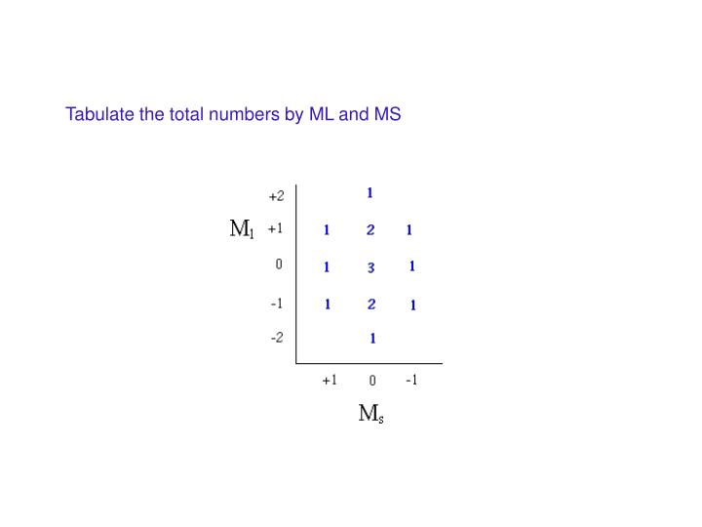
Steps to assign spectroscopic term symbol

Slide 13
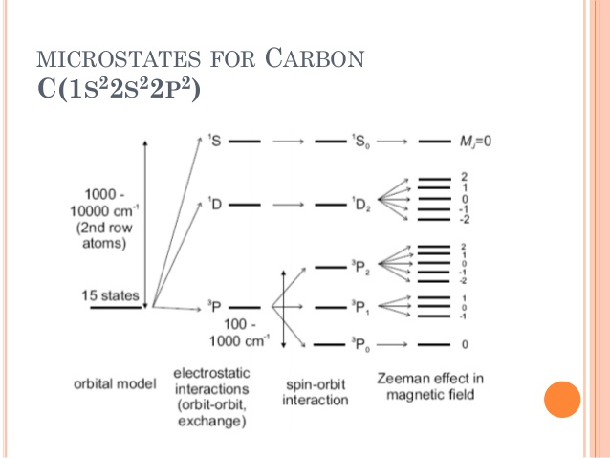

Slide 14
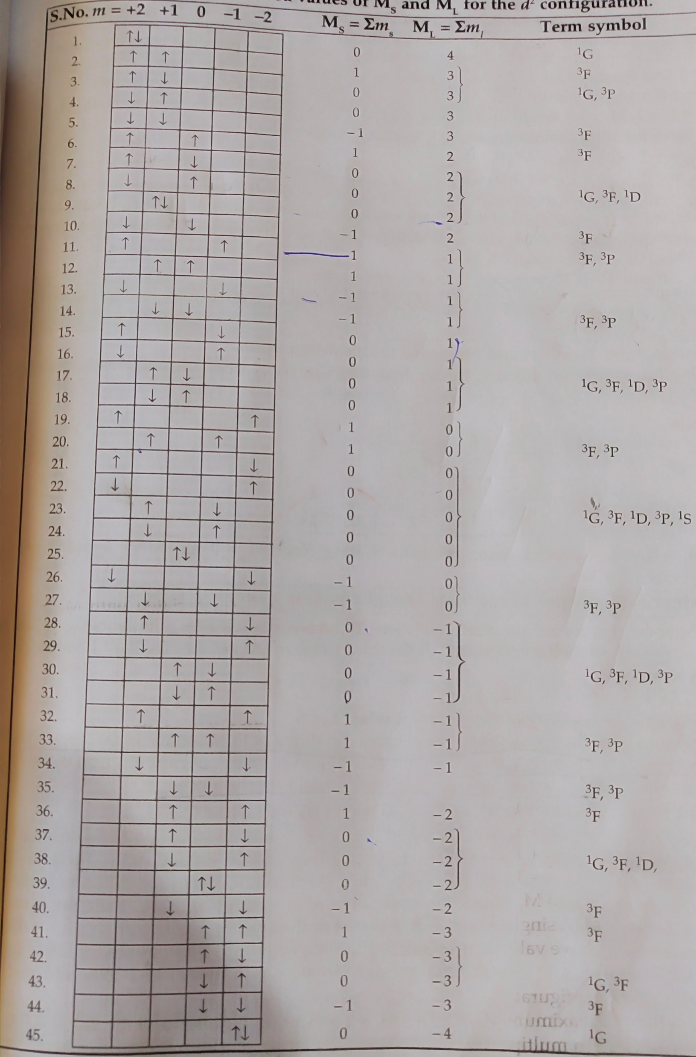
Derivation of Term Symbols for d² Configuration
For d electrons, the subsidiary quantum number l =2.
For two d-electrons having l₁ = 1 and l₂ = 2,
L = 4, 3, 2, 1, 0
S = 1, 0
2S + 1 =3 and 1
There are 45 ways in which two d electrons may be arranged which do not violate the Pauli Exclusion Principle. These arrangements are shown in a table

Slide 15
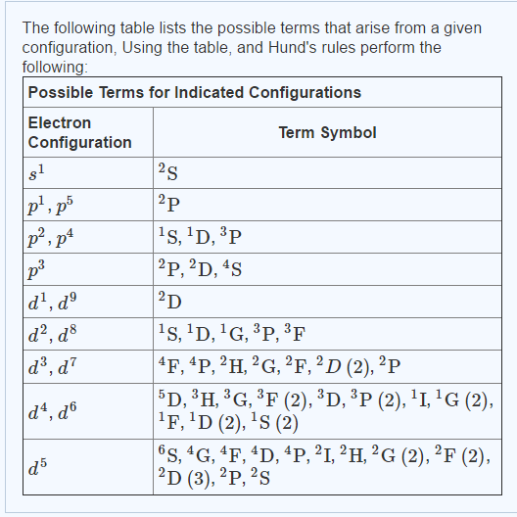

Slide 16
Calculation of Number of Microstates
The number of microstates possible for any electronic configuration may be calculated from the formula:-
Number of microstates = n! / r! (n - r)!
Where n is the twice the number of orbitals,
r is the number of electrons
! is the factorial.
For p² configuration,
n= 3x2 =6; r = 2; n – r = 4; 6! = 6 x 5 x 4 x 3 x 2 x 1 = 720; 2! = 2 x 1 =2; 4! = 4 x 3 x 2 x 1 = 24
Substituting in the formula, we get
Number of microstates =15.
Similarly, for a d² configuration,
Number of microstates = 10! / 2! (10 – 2)!
Thus a d² configuration will have 45 microstates.

Slide 17
Selection Rules
1. Spin selection rule
The selection Rule for Spin Angular Momentum is
Δ S = 0
Thus transitions such as 2S→ 2P and 3D→ 3P are allowed,
but transition such as 1S→ 3P is forbidden.
The same rule is also stated in the form of a statement,
Electronic Transitions between the different states of spin multiplicity are forbidden.
The selection Rule for total angular momentum, J, is
Δ J = 0 or ± 1
The transitions such as ²P_{1/2} → ²D_{3/2} and ²P_{3/2} → ²D_{3/2} are allowed, but transition such as
²P_{1/2} → ²D_{5/2} is forbidden since Δ J= 2.
There is no selection rule governing the change in the value of n, the principal quantum
number..

Slide 18
2. Laporte selection rule: Also known as orbital selection rule. This rule states that transitions between the orbitals of the same sub shell are forbidden. In other words,
For total orbital angular momentum is Δ L = ± 1. This is La Porte allowed transitions. Thus transition such as ¹S→ ¹P and ²D→ ²P are allowed
But transition such as ³D→ ³S is forbidden since Δ L = -2 .
Hence transitions from gerade to ungerade (g to u) or vice versa are allowed, i.e., u → g or g → u but not u → u or g → g.
In the case of p sub shell, both ground and excited states are odd and in the case of d sub shell both ground and excited states are even. As a rule transition should be from even to odd or vice versa. T
he same rule is also stated in the form of a statement instead of an equation: Electronic transitions within the same p or d sub-shell are forbidden, if the molecule has centre of symmetry.

Slide 19
According to Laporte selection rule, d-d transitions of octahedral complexes are forbidden. Then why moderately strong spectra actually observed?

Slide 20
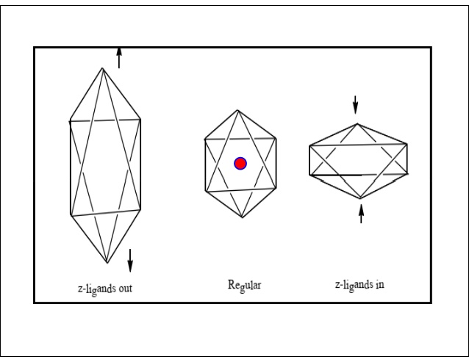

Slide 22
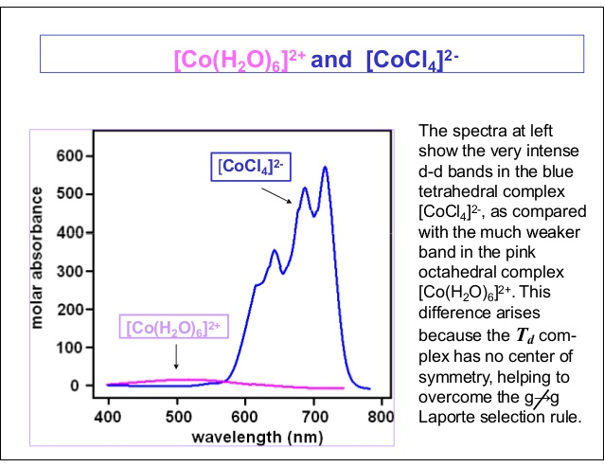

Slide 23
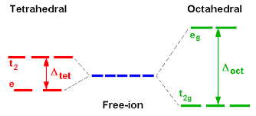
Splitting of Russell Saunders states in octahedral and tetrahedral states
The symbols A(or a) and B (or b) with any suffixes indicate wave functions which are singly degenerate. Similarly E (or e) indicates double degeneracy and T (or t) indicates triple degeneracy.
Lower case symbols, a1g, a2g, eg, etc., are used to indicate electron wave functions(orbitals) and upper case symbols are used to describe electronic energy levels. Thus ²T_{2g} means an energy level which is triply degenerate with respect to orbital state and also doubly degenerate with respect to its spin state.
Upper case symbols are also used without any spin multiplicity term and they then refer to symmetry (ex., A1g symmetry). The subscripts g and u indicate gerade (even) and ungerade (odd).
d orbitals split into two sets - t_{2g} orbitals and e_{g} orbitals under the influence crystal field.
f orbitals split into three sets, having symmetries A_{2u}, T_{2u} and T_{1u}.

Slide 25
In an Octahedral field
S and P states do not split
D state split into two states
F state split into three states
G state split into four states
Thus states split by external field are called Mulliken Symbols. These symbols are extensively used in interpreting electronic spectra of TM complexes.

Slide 26
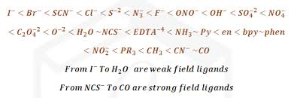
Spectrochemical Series for Ligands

Slide 27
NATURE OF ELECTRONIC TRANSITONS & SPECTRA OF TM COMPLEXES: ORGEL ENERGY LEVEL DIAGRAMS

Slide 28
Spectra of d¹ and d⁹ ions
Octahedral Complexes of Metal ion with d¹ configuration

Slide 29
Octahedral Complexes of Metal ion with d⁹ configuration

Slide 30
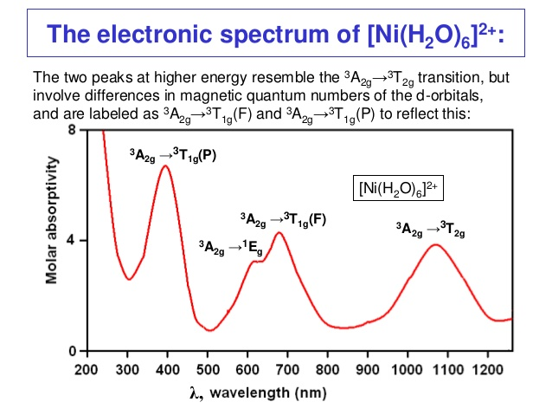
Octahedral Complexes of Metal ions with d⁸ configuration

Slide 31
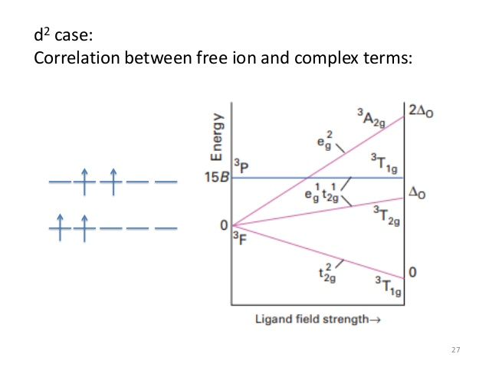

Slide 33
